Slide 1
Dataset 1
Drop Null rows in attr_1, age & attr_2 in user.csv

Slide 2
PCA Eigen Value & Loadings

Slide 3
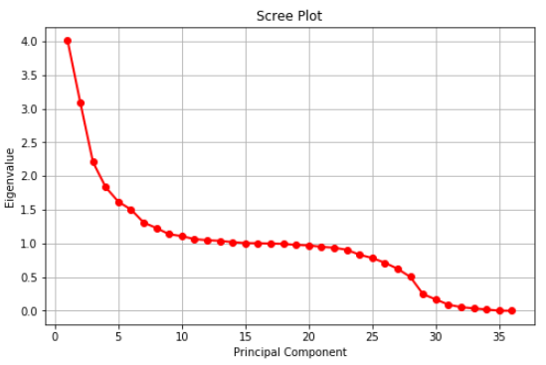
PCA Scree plot

Slide 4
PCA Eigen Vectors

Slide 5
LDA
PCA

Slide 6
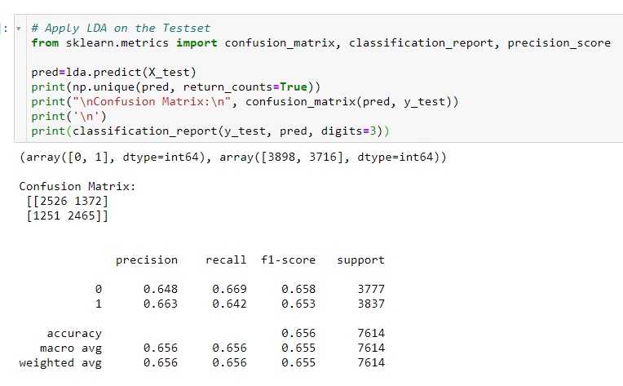
LDA on Test Set

Slide 7
Dataset 2
Drop Null cols in attr_1 & age in user.csv

Slide 8
PCA Eigen Value & Loadings

Slide 9
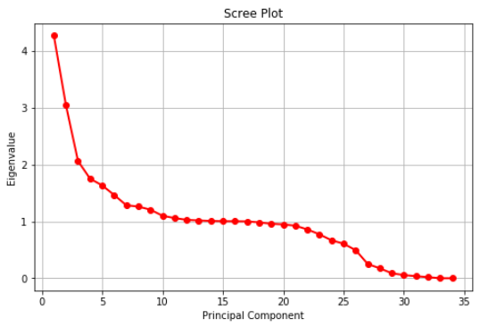
PCA Scree plot

Slide 10
PCA Eigen Vectors

Slide 11
LDA
PCA

Slide 12
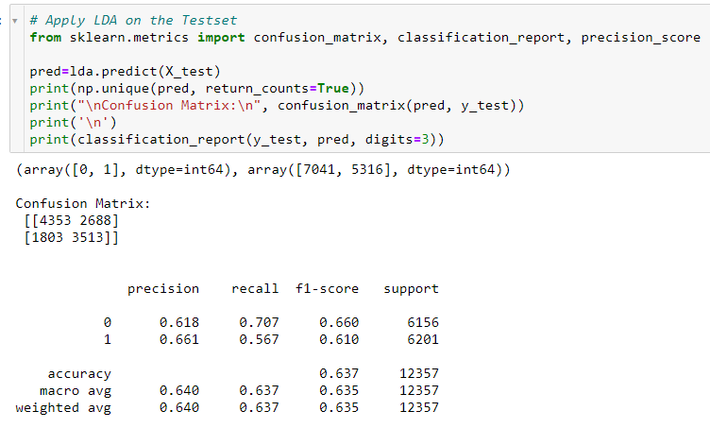
LDA on Test Set

Slide 13
Dataset 3
Add mean value to attr_1, attr_2 & age in user.csv

Slide 14
PCA Eigen Value & Loadings

Slide 15
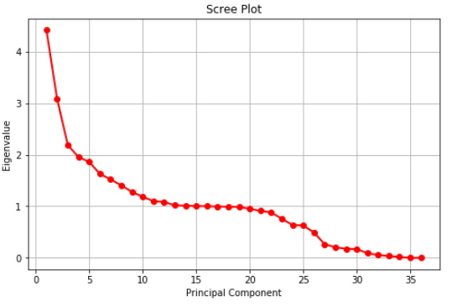
PCA Scree plot

Slide 16
PCA Eigen Vectors

Slide 17
LDA
PCA

Slide 18
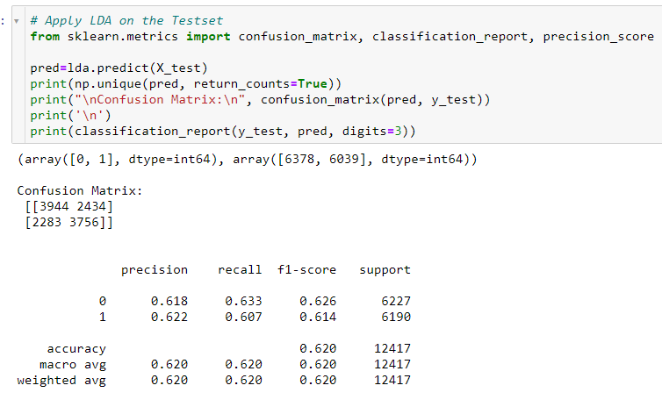
LDA on Test Set

Slide 19
Dataset 4
Add median value to attr_1, attr_2 & age in user.csv

Slide 20
PCA Eigen Value & Loadings

Slide 21
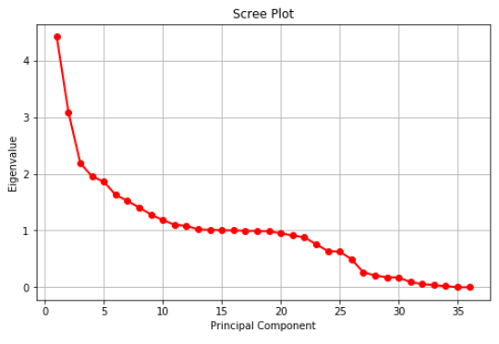
PCA Scree plot

Slide 22
PCA Eigen Vectors

Slide 23
LDA
PCA

Slide 24
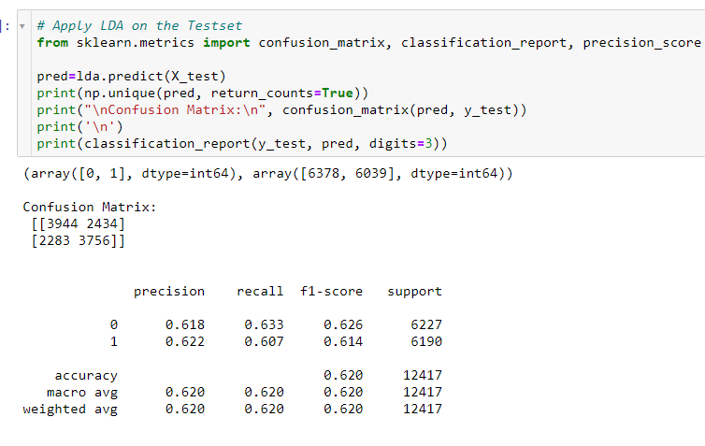
LDA on Test Set

